Slide 1
Twitter Movie Reviews Ryan Ellison, Richard Hui
CS 579

Slide 2
Project Recap
Collect tweets about currently-playing movies
Hand-label collected tweets as positive or negative
Train a sentiment analysis model (use logistic regression)
Create new movie ratings based on sentiment in tweets
Compare our ratings to Rotten Tomatoes, IMDb, and Metacritic

Slide 3
Project Methods
Collect tweets using Twitter Streaming API
Hand-label a set of training/test tweets from a variety of movies
(‘track’ included movie, movies… & remove RT )
Train a sentiment analysis model with logistic regression
(use ‘sklearn’ for feature extraction, logistic regression)
Collect tweets on specific movies
Use model to estimate percentage of positive/negative tweets

Slide 4
Model Accuracy/Validation
Average 5-fold cross validation accuracy of 0.7 (std = 0.08)
Top weighted terms for “good” movies:
(good, love, again, one, favorite, loved, wow…)
Top weighted terms for “bad” movies:
(why, some, but, to, they, this, didn…)
Reasonable classifications in spot-checking of unlabeled tweets

Slide 5
Movie Rating Process/Results
Collect tweets on a movie to rate, ignoring retweets
Collect tweets across a range of times (use all that qualify)
Twitter ratings more positive, on average, than other rating sites
Collecting additional data only widened rating gap in some cases
Twitter rating’s “top pick” agrees with other sites

Slide 6
Movie Rating Process/Results

Slide 7
Twitter Rating Limitations
Twitter ratings work best for new and popular movies
Ratings focus more on viewing experience than movie quality
Not always clear what the “right” rating should be
Lots of tweets mention movies without being positive or negative
(e.g., “I am at XYZ movie.”)

Slide 8
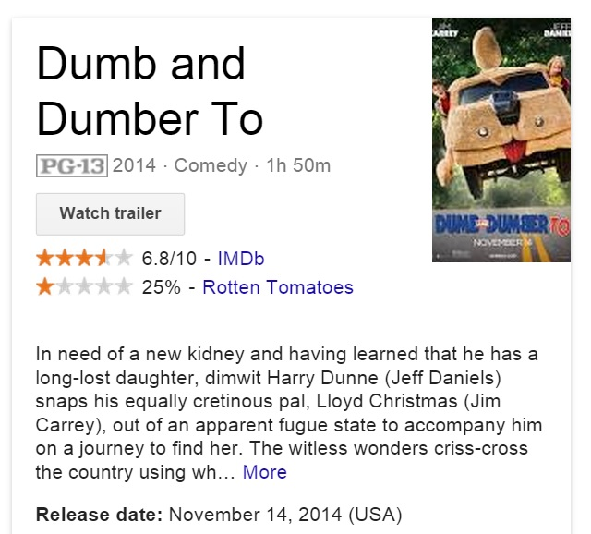
Rating Example

Slide 9
Project Results Analysis
Twitter “reviews” talk about movie experience/emotions
Overall sentiment tends to be more positive than review services
Not in complete agreement with other review services
(…but, other services widely disagree with each other, too)
Goal of quicker feedback than other sites realized for popular movies
Useful additional source of community feedback

Slide 10
Questions?

